Slide 1
Smooth Sort

Slide 2
Science of Computer Programming
Volume 1, Issue 3, Pages 223–233
Smoothsort, an alternative for sorting in situ
(Edsger Wybe)
http://www.sciencedirect.com/science/article/pii/0167642382900168

Slide 3
Contents
What is Smoothsort
Heapsort Analysis
Idea: A family of heaps
Leonardo Numbers & Trees
Smoothsort operations
Algo & Runtime Analysis
Conclusion

Slide 4
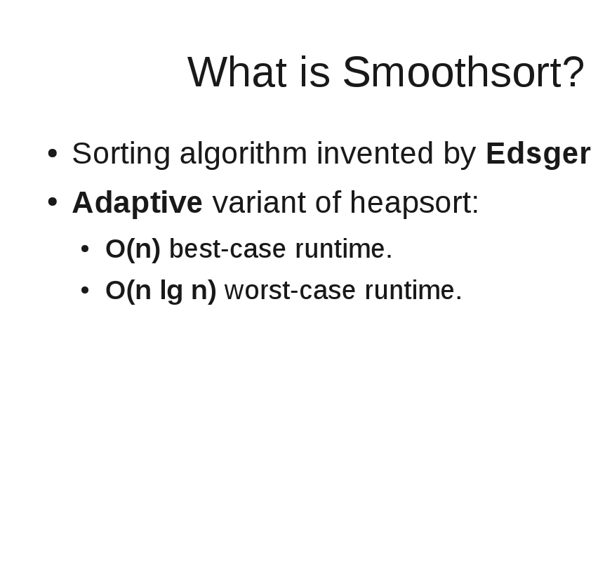
Waybe

Slide 5
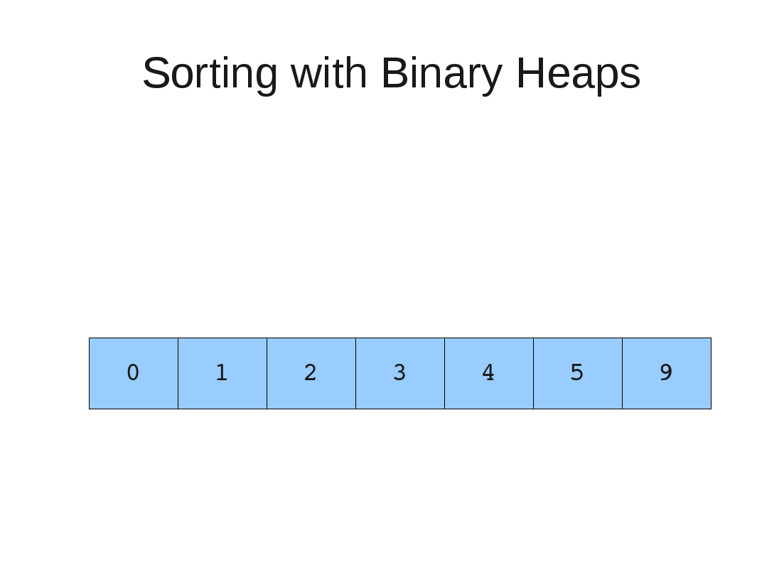

Slide 6
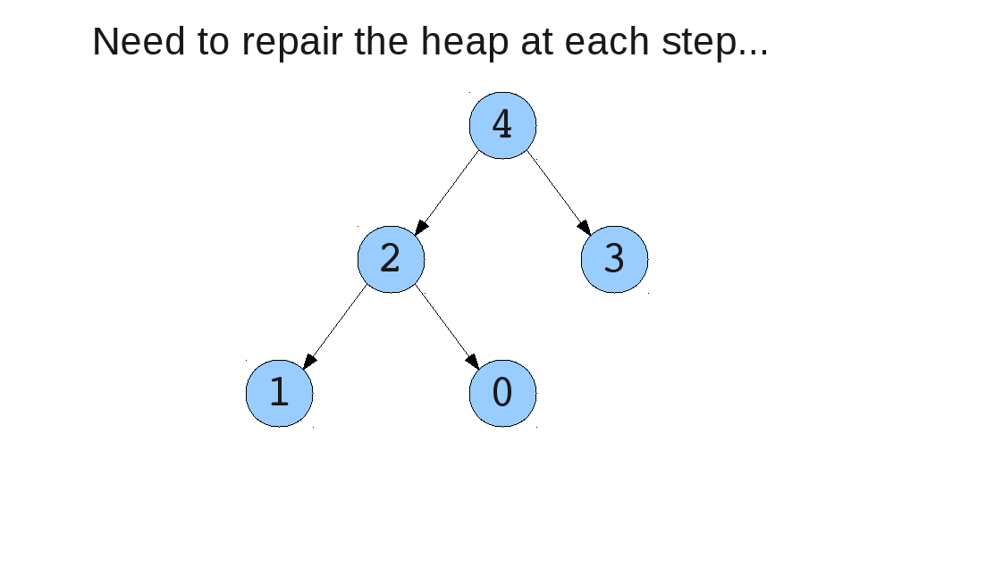
Why is Heapsort O(n lg n)?

Slide 7
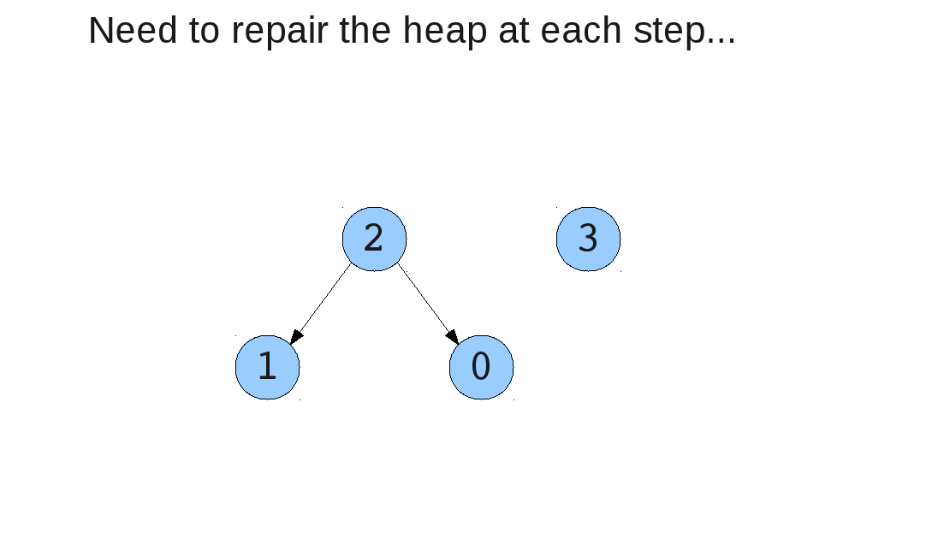
Why is Heapsort O(n lg n)?

Slide 8
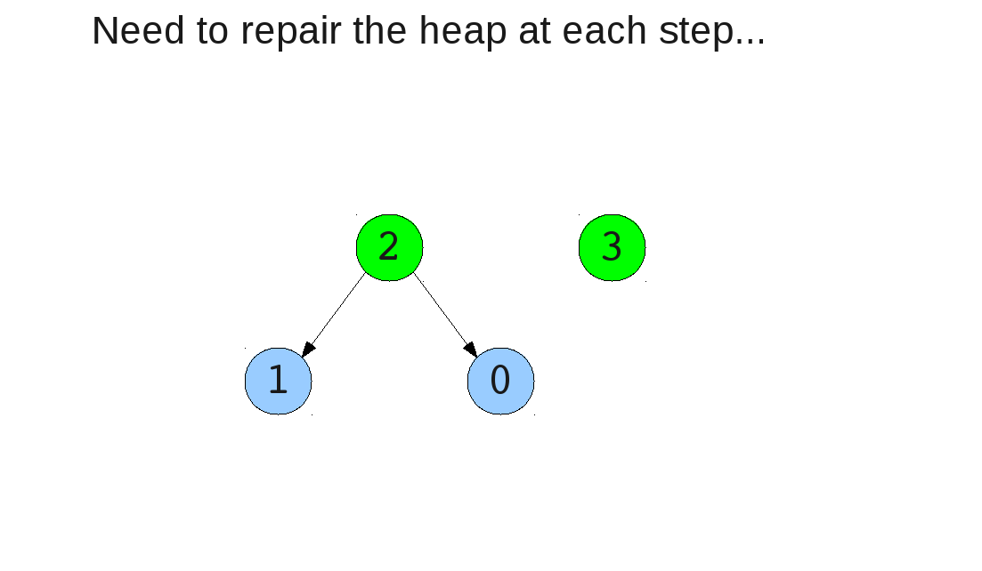
Why is Heapsort O(n lg n)?

Slide 9
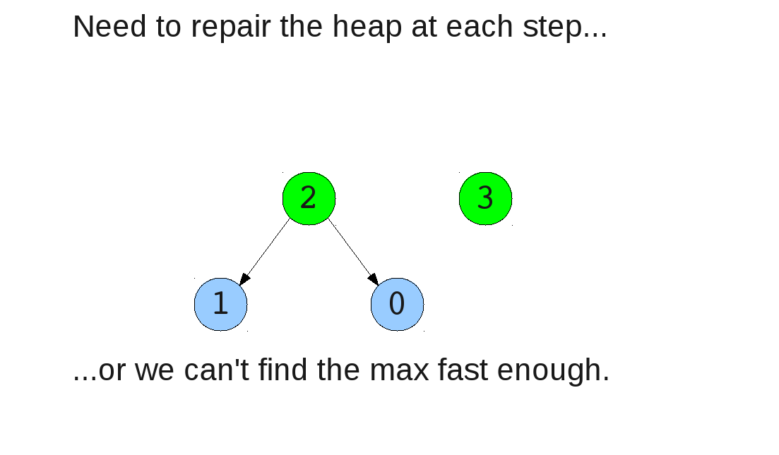
Why is Heapsort O(n lg n)?

Slide 10
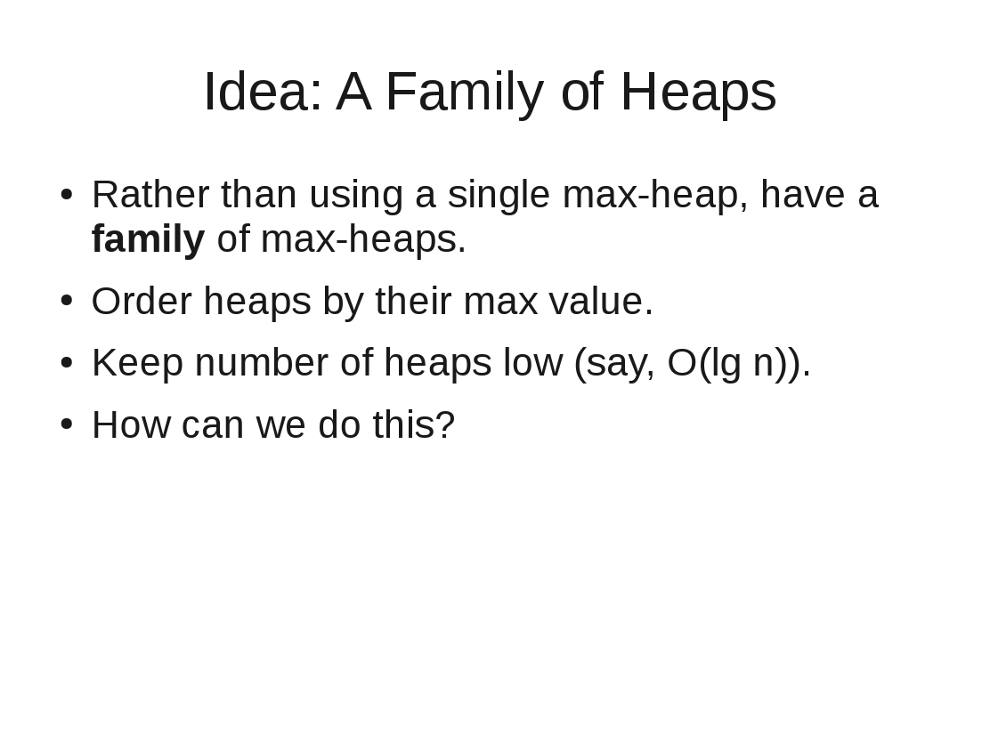

Slide 11
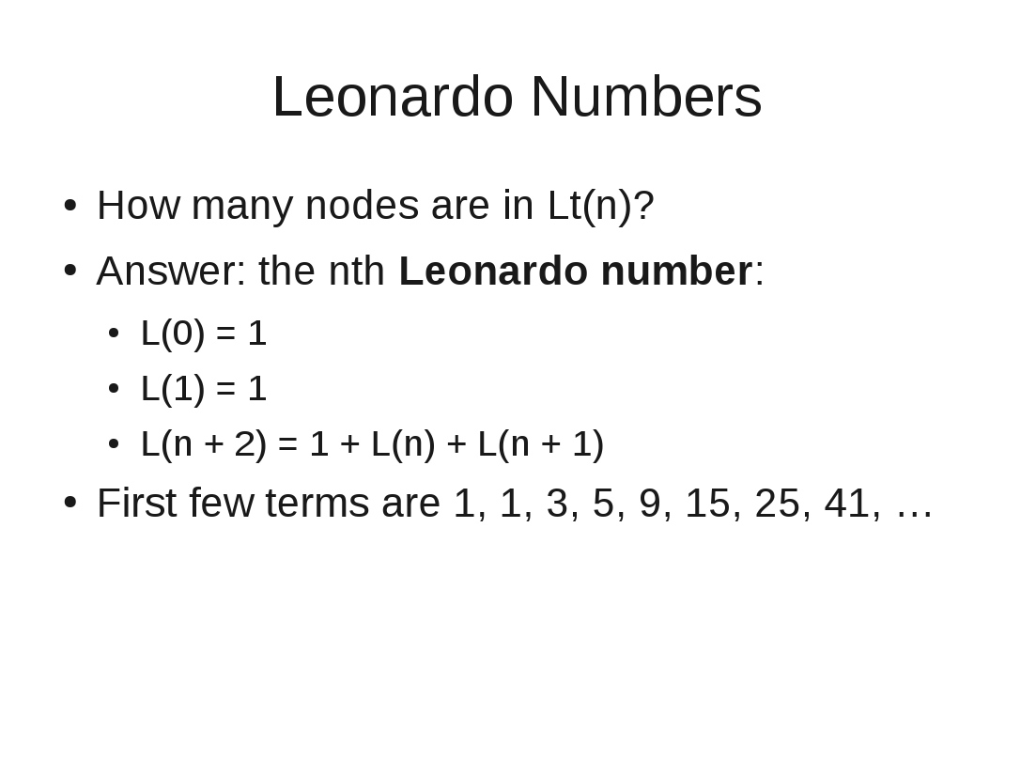

Slide 12
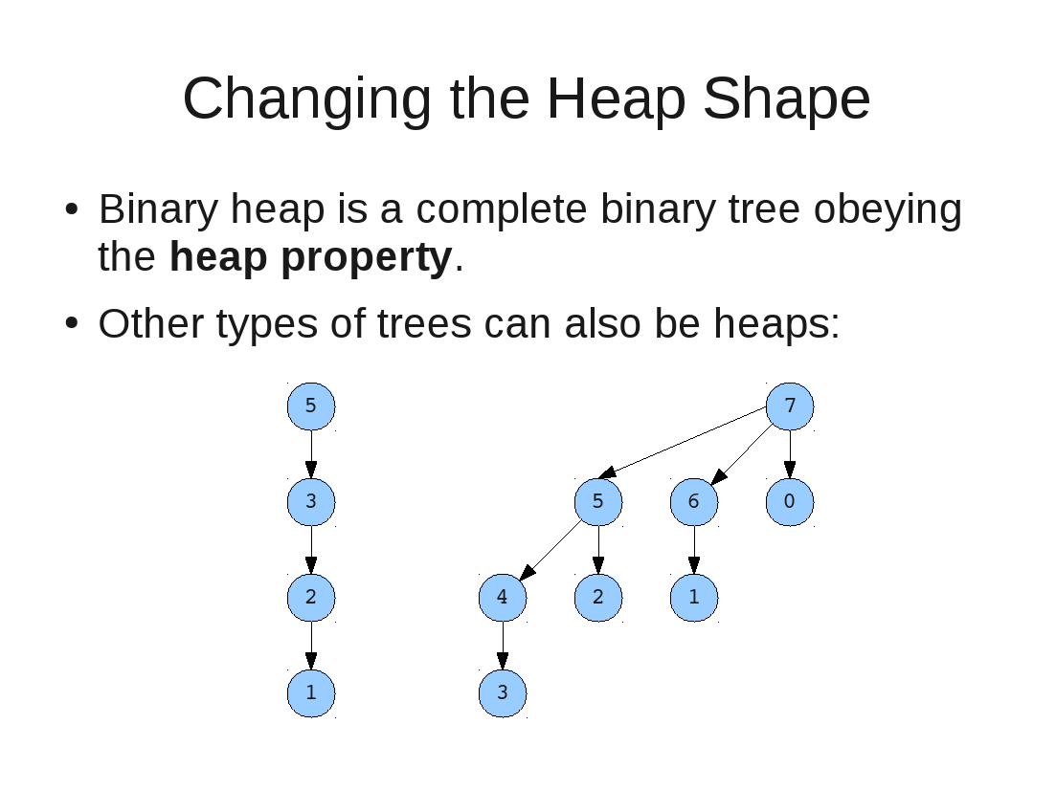

Slide 13
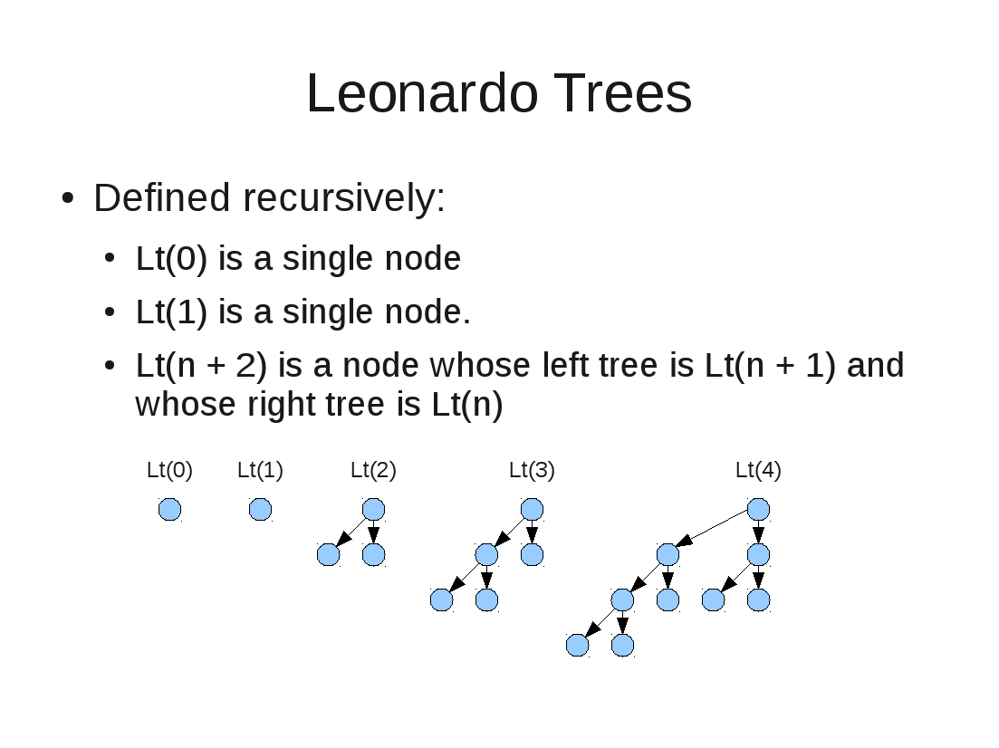

Slide 14
Building a Leonardo Heap
Insert Operation

Slide 15
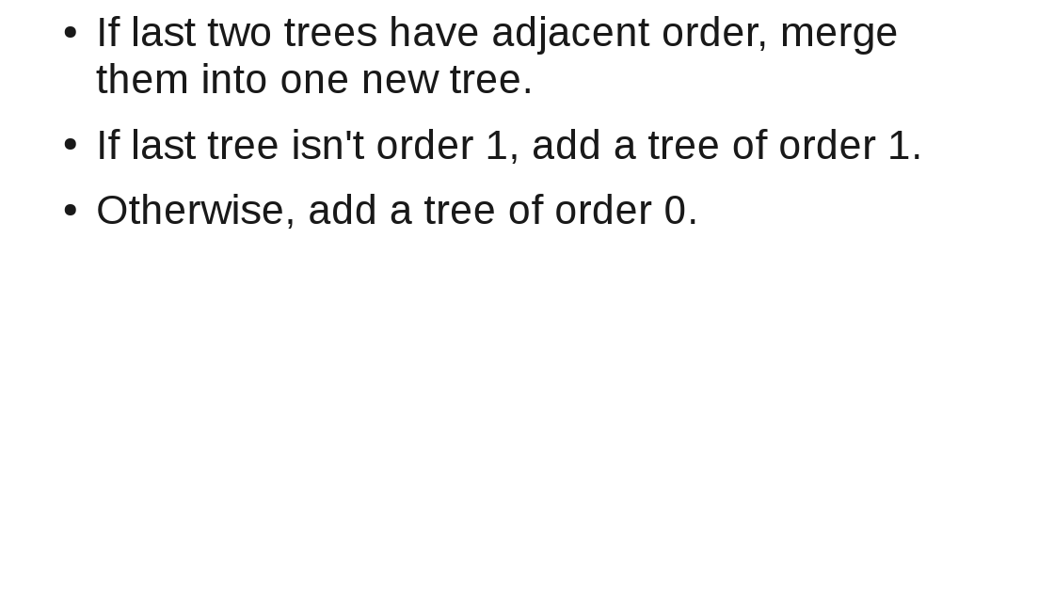
Insert Operation

Slide 16
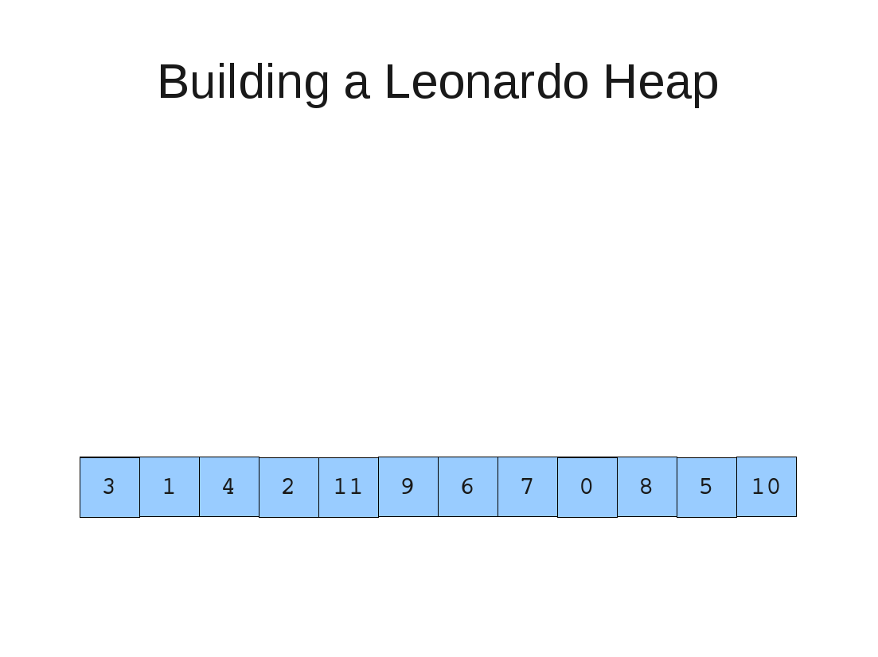

Slide 17
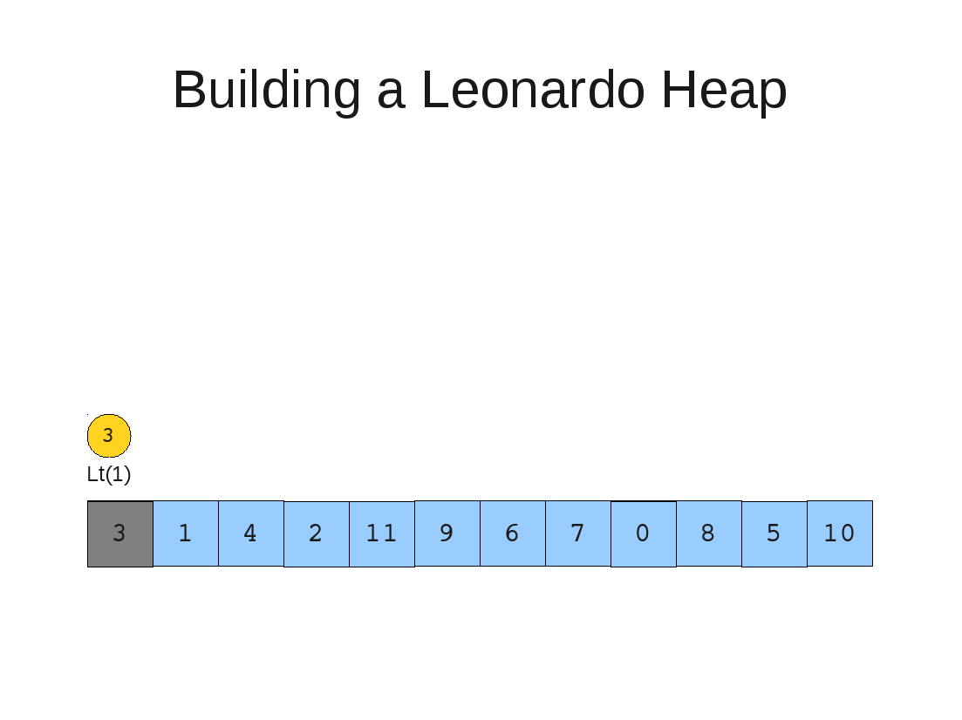

Slide 18
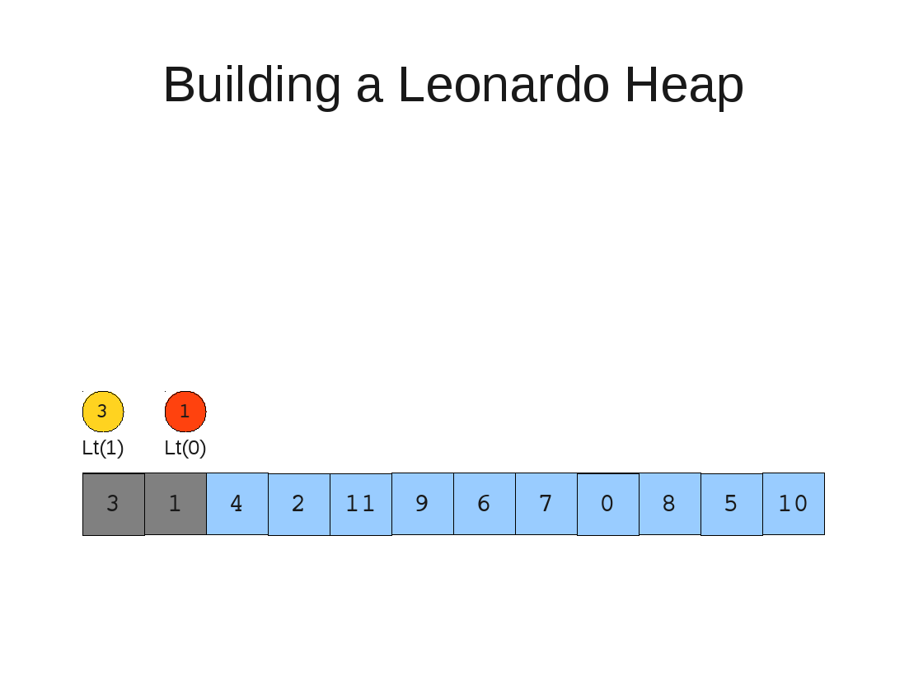

Slide 19


Slide 20
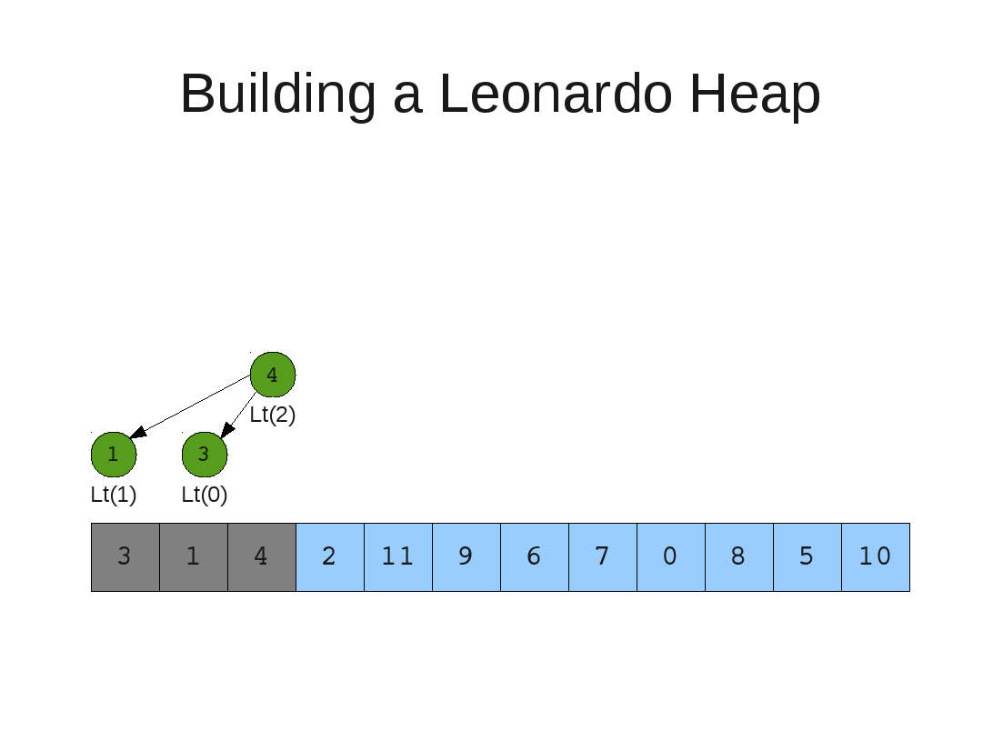

Slide 21
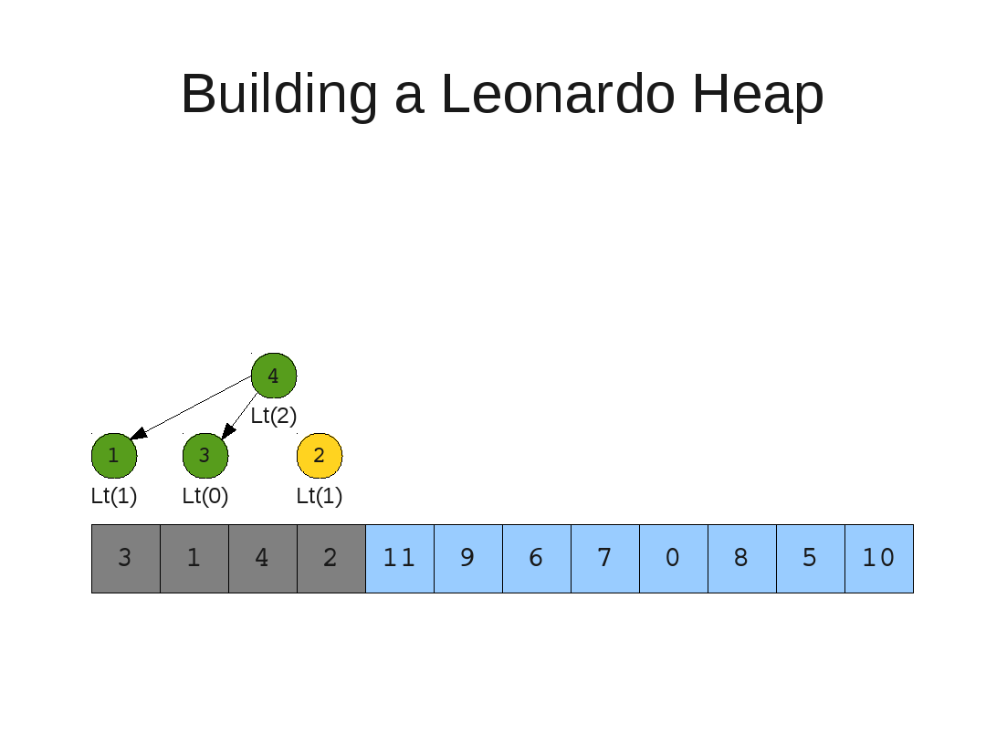

Slide 22


Slide 23


Slide 24
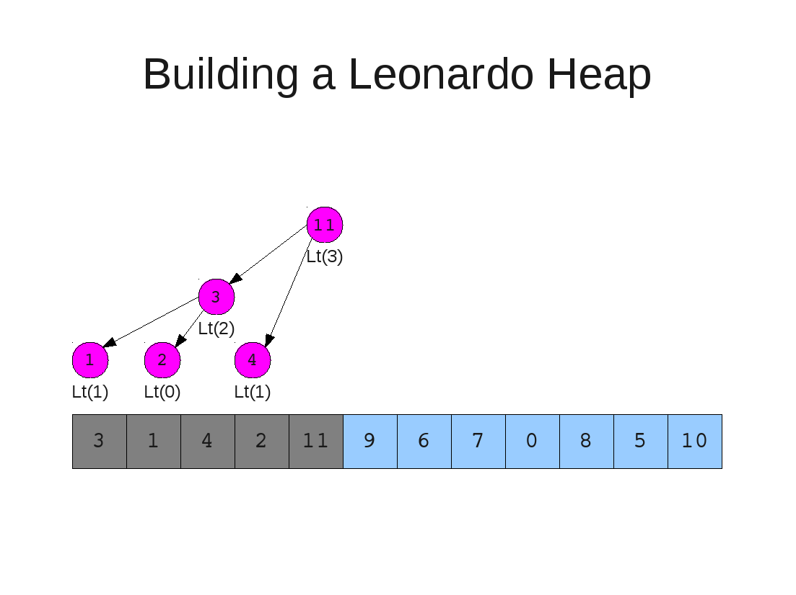

Slide 25
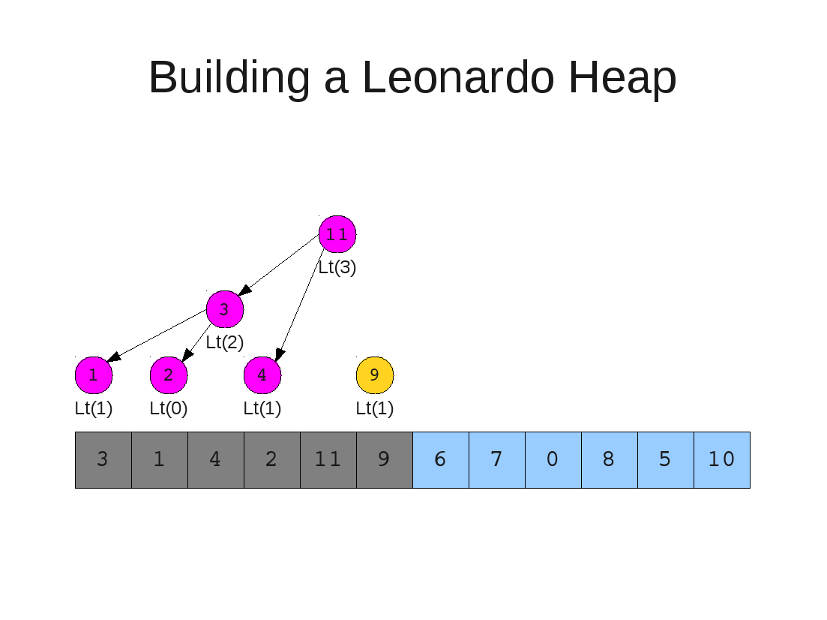

Slide 26


Slide 27
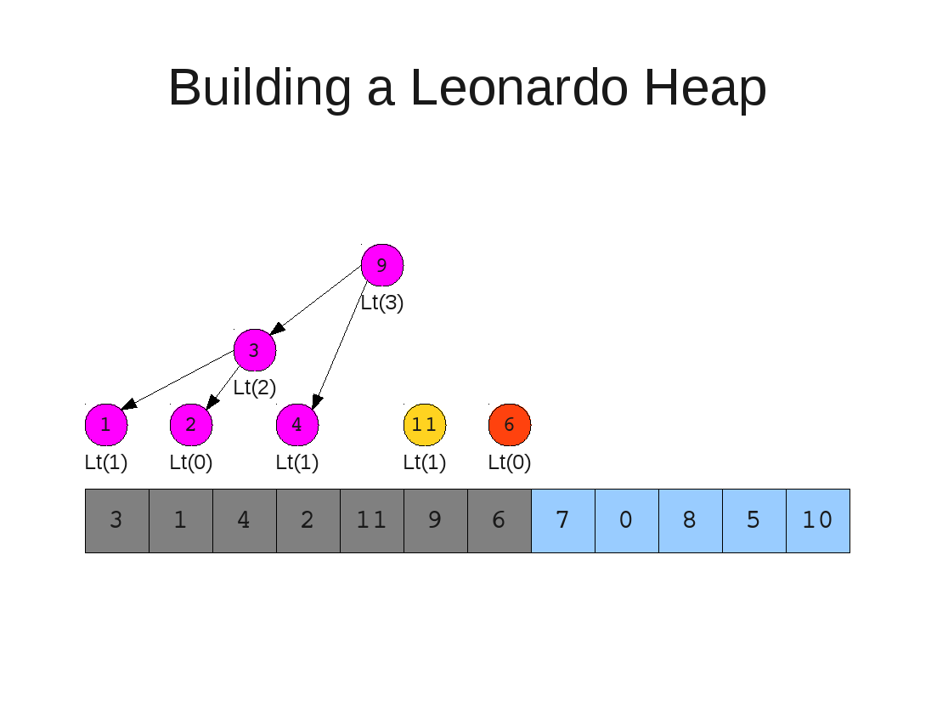

Slide 28


Slide 29


Slide 30
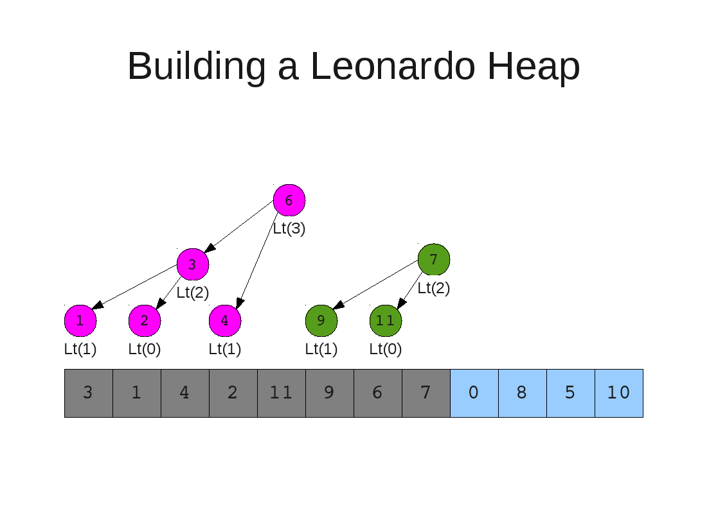

Slide 31
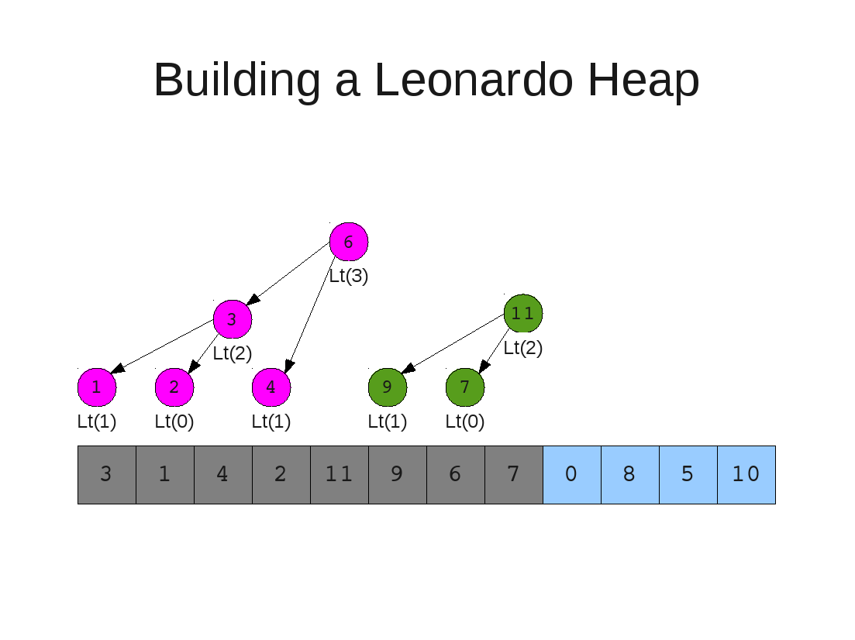

Slide 32
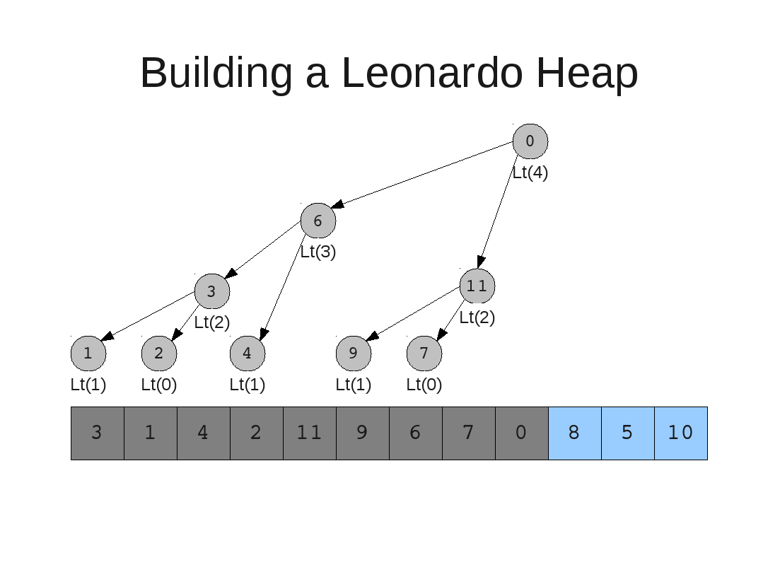

Slide 33


Slide 34


Slide 35
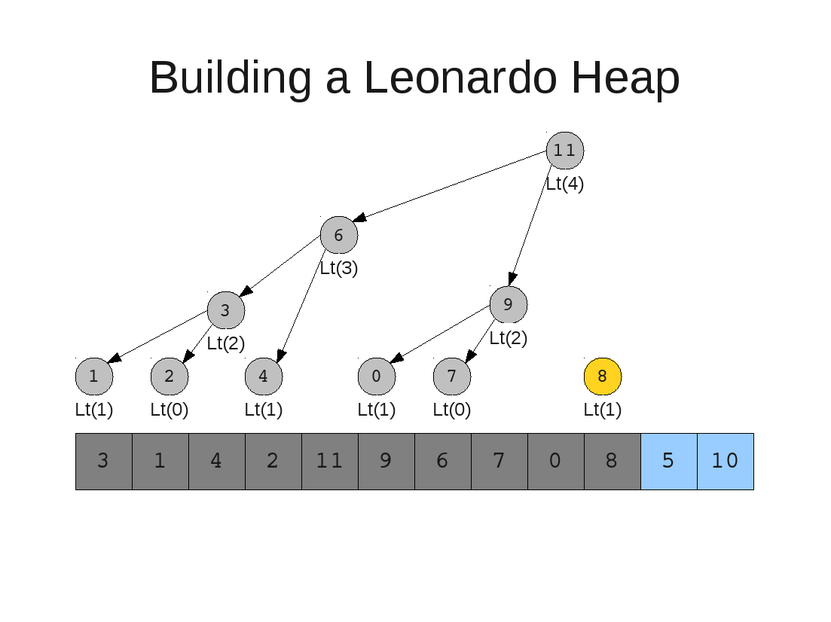

Slide 36


Slide 37


Slide 38
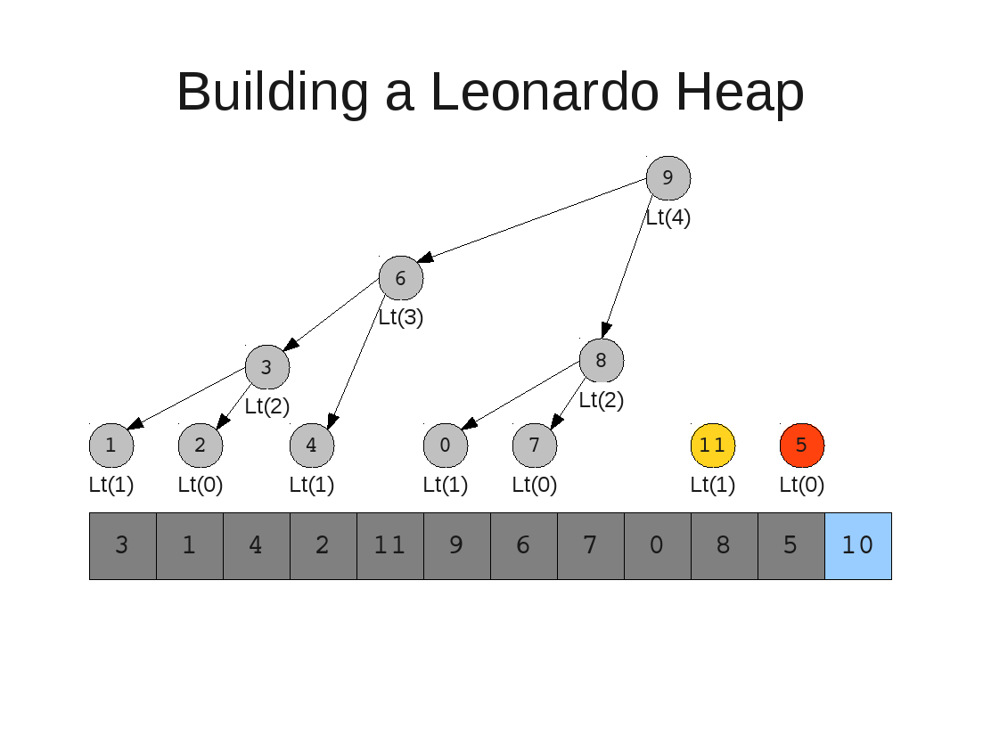

Slide 39


Slide 40


Slide 41


Slide 42


Slide 43
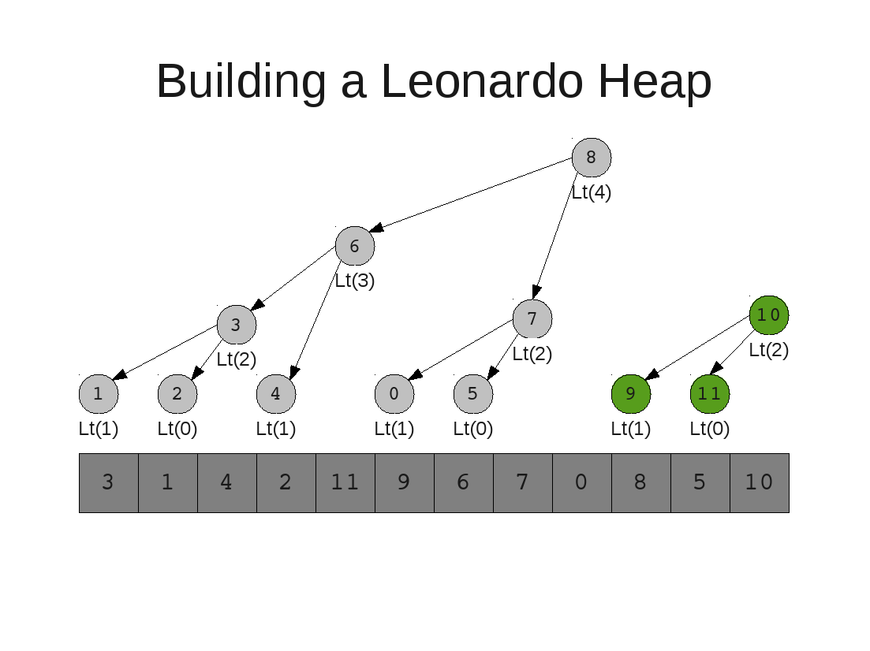

Slide 44


Slide 45
DE queuing from a Leonardo Heap
Remove Operation

Slide 46
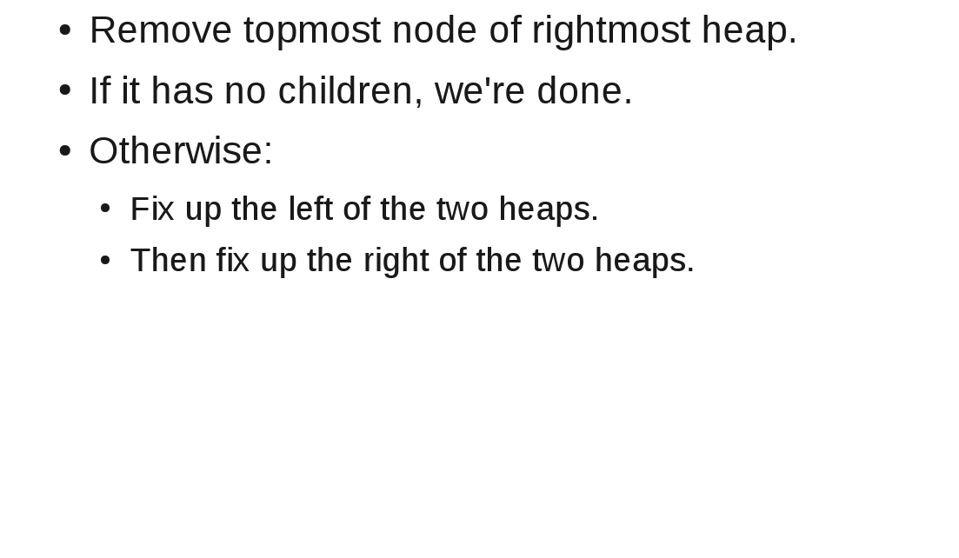
Dequeue Operation

Slide 47
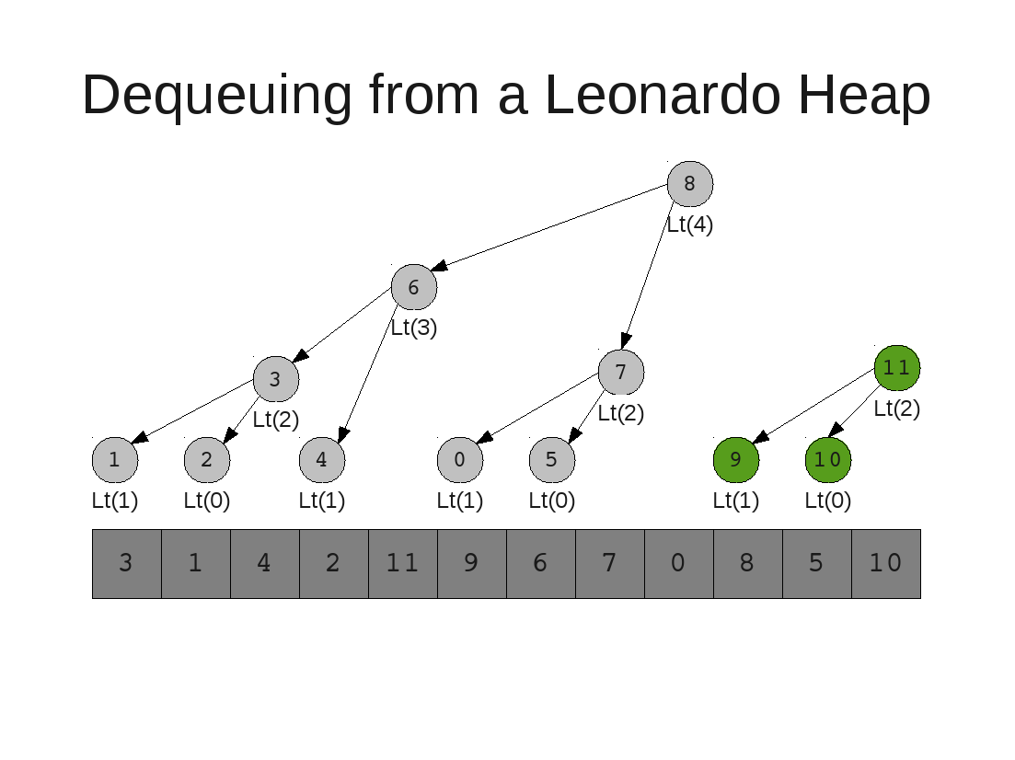

Slide 48
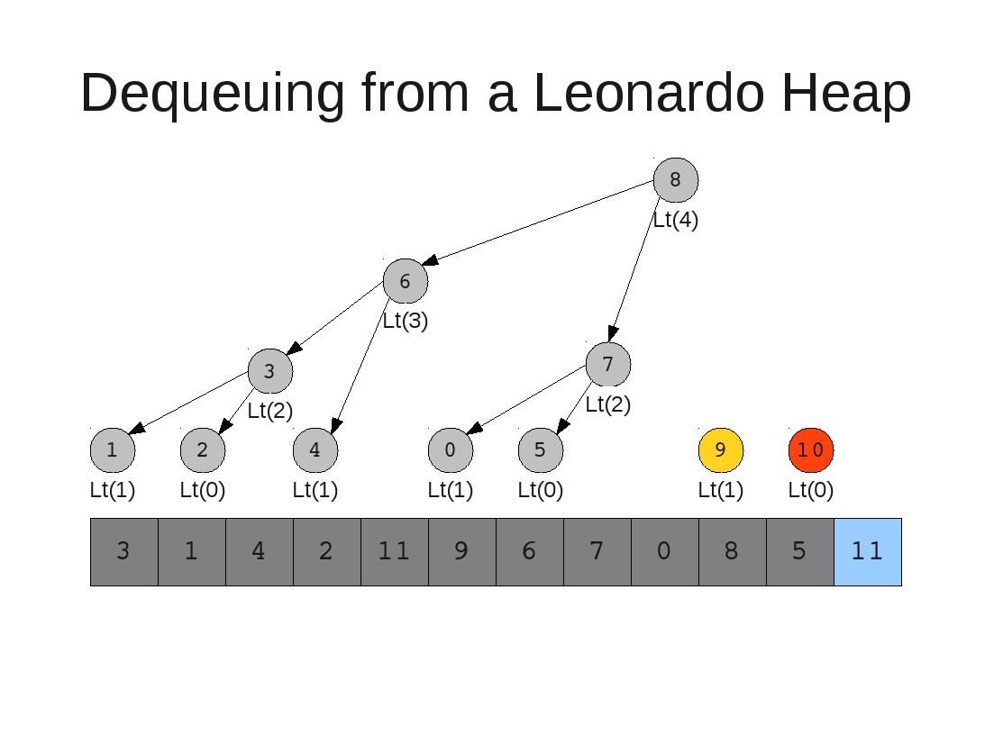

Slide 49
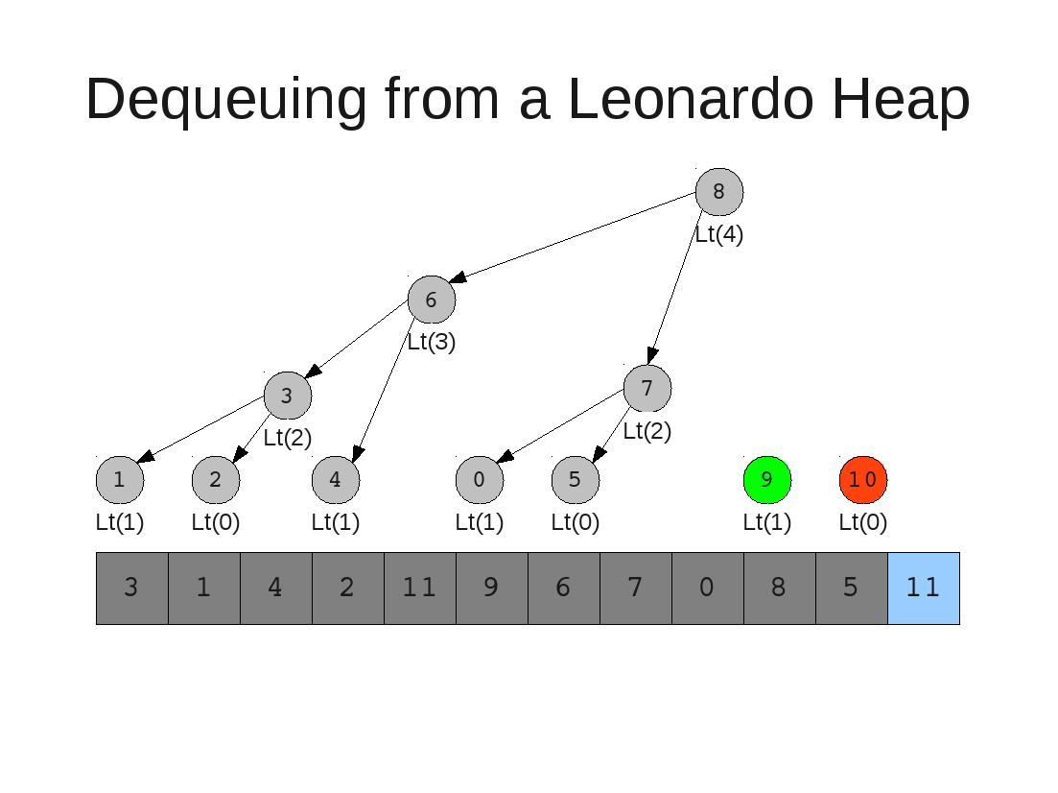

Slide 50
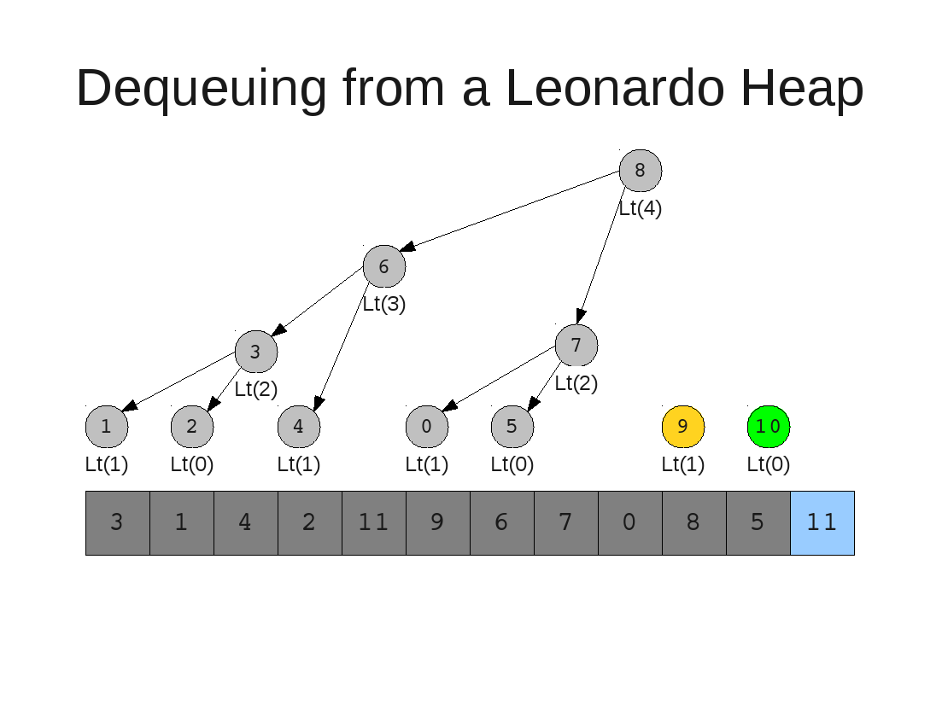

Slide 52
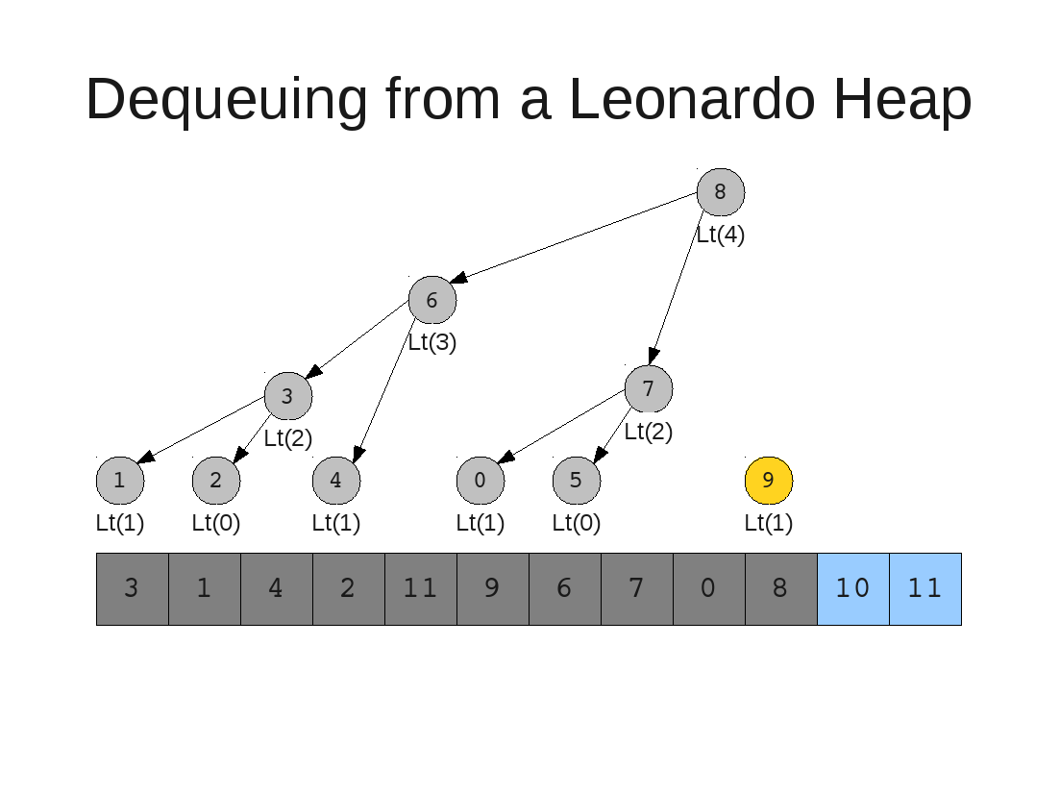

Slide 53
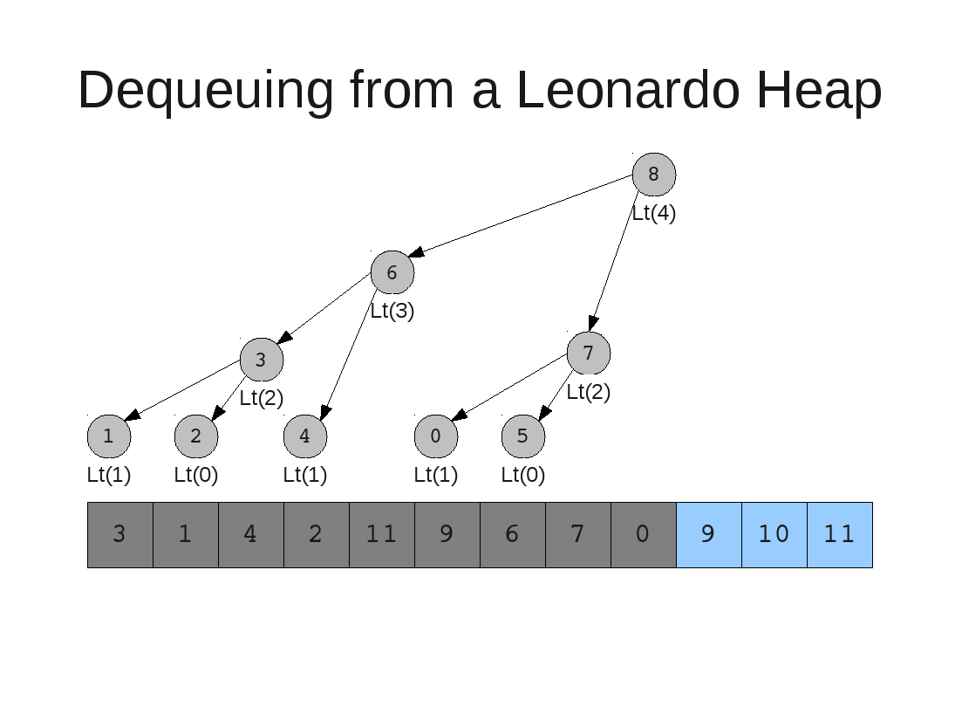

Slide 54
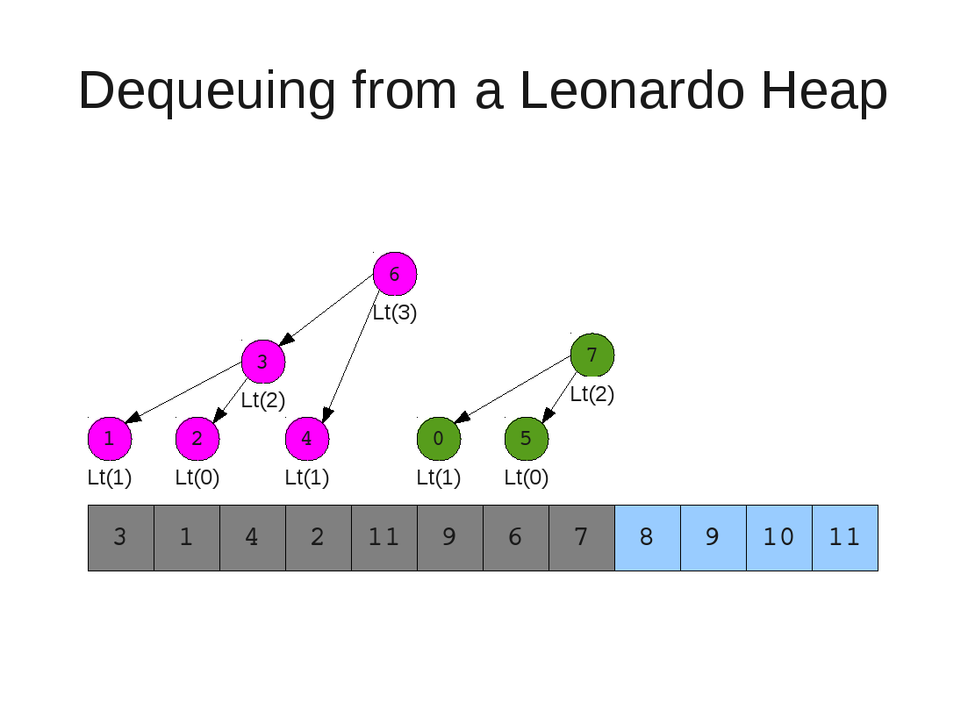

Slide 55
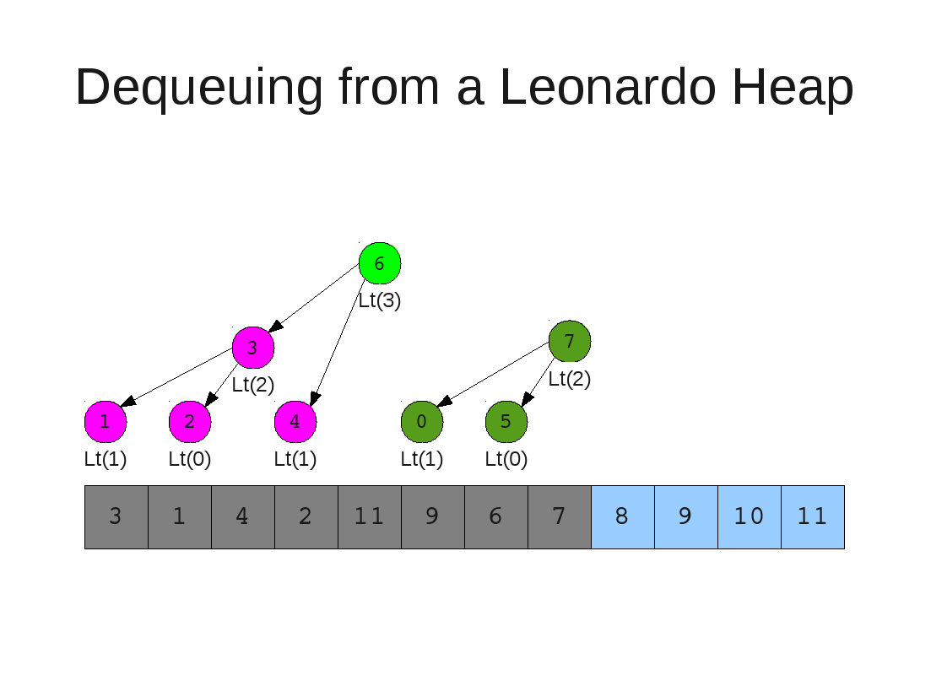

Slide 56
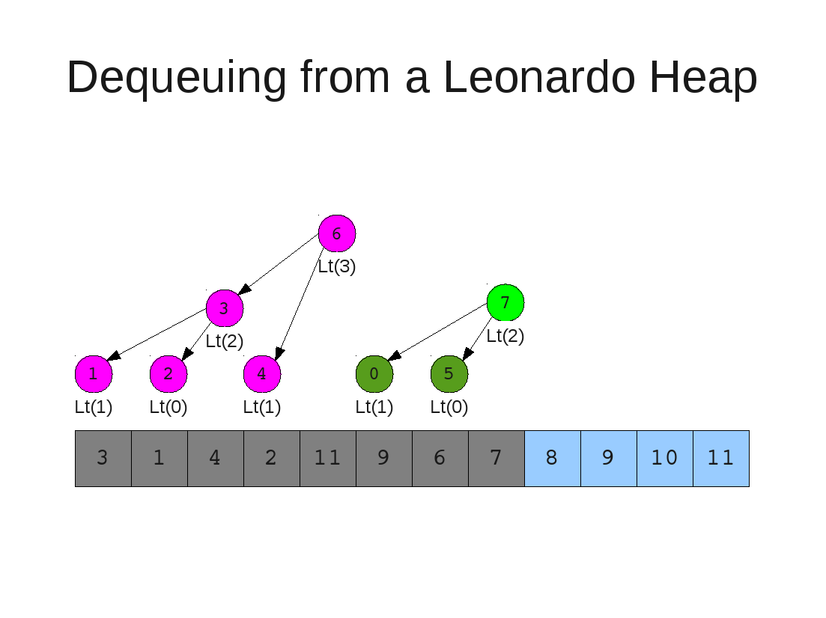

Slide 58
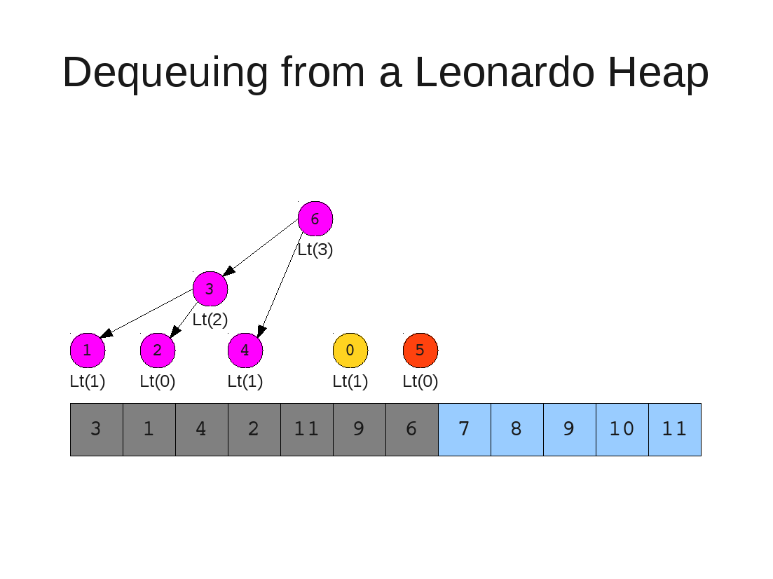

Slide 59
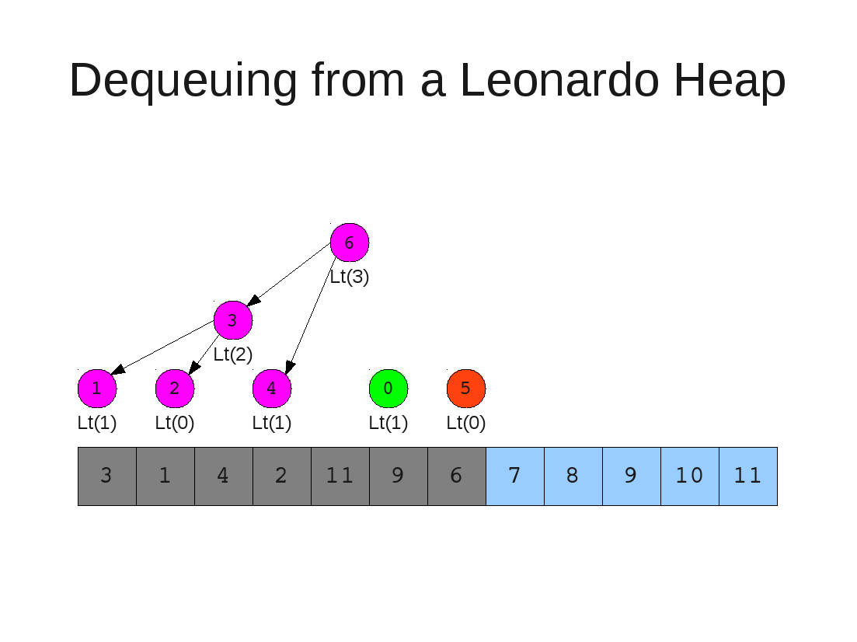

Slide 60
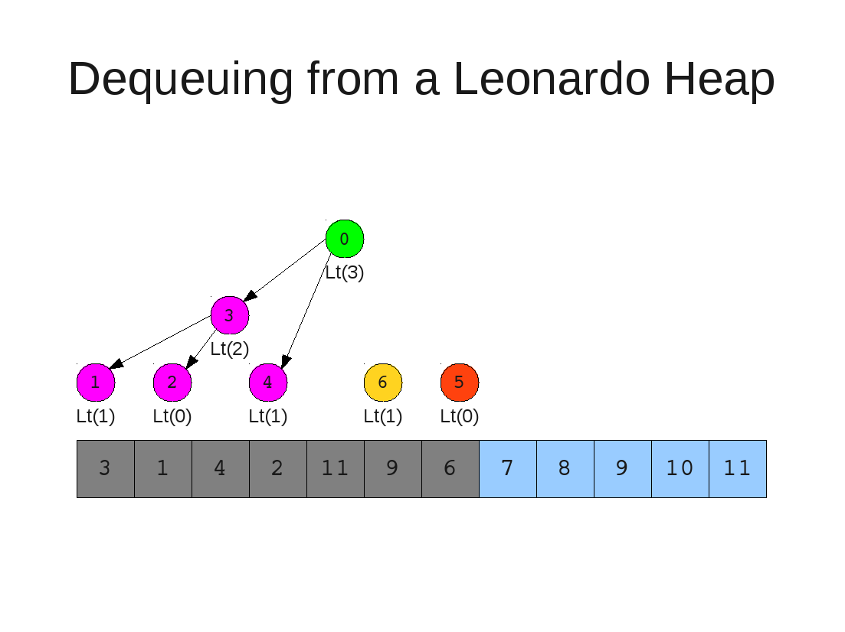

Slide 61


Slide 62


Slide 63
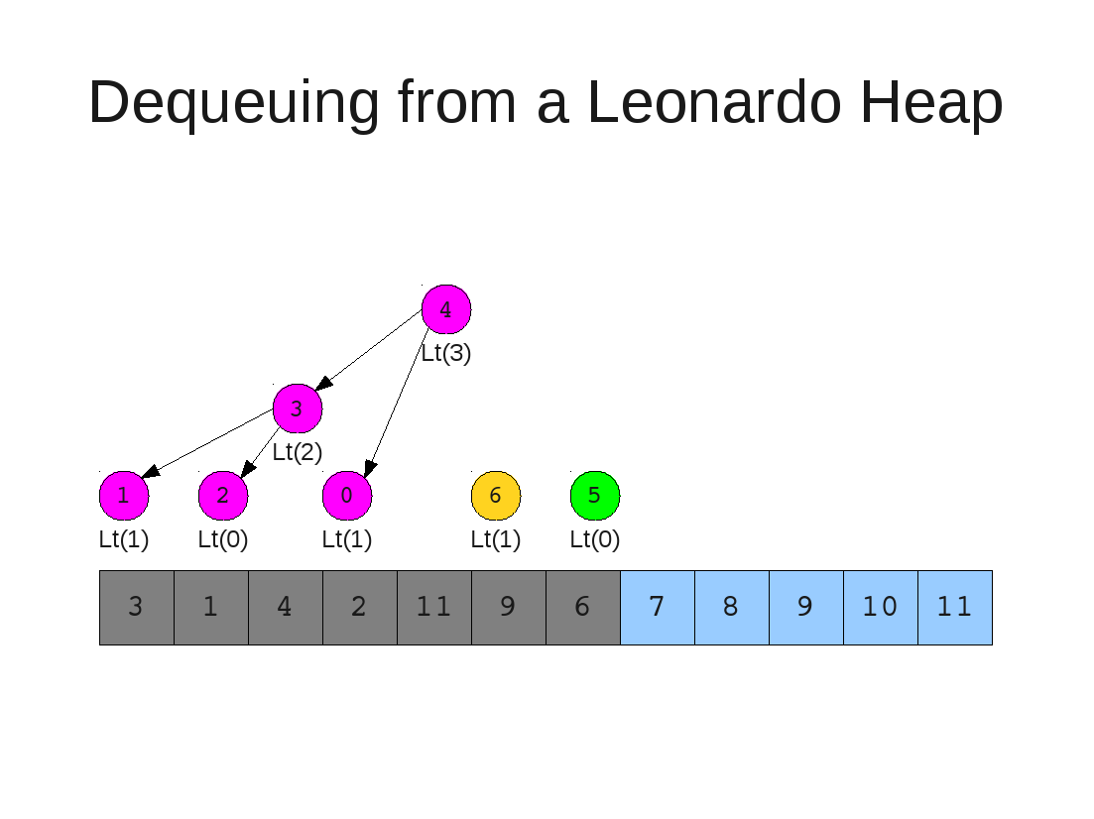

Slide 64


Slide 65


Slide 66
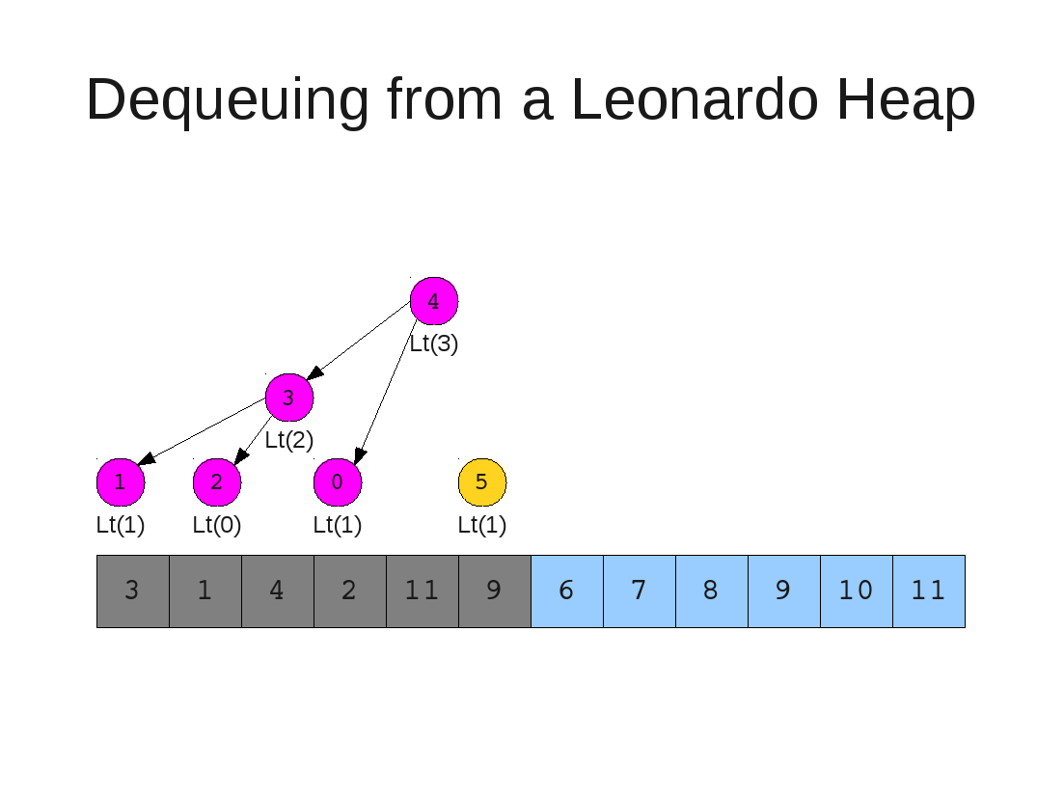

Slide 67
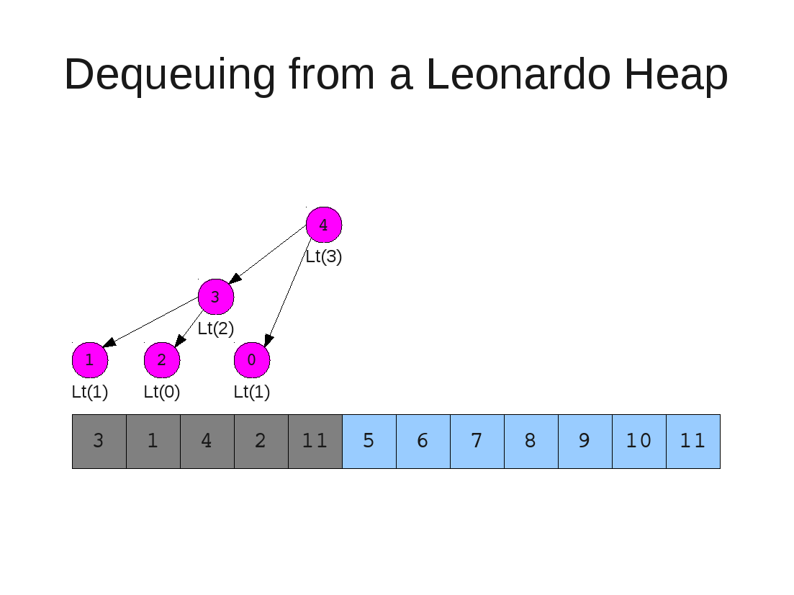

Slide 68
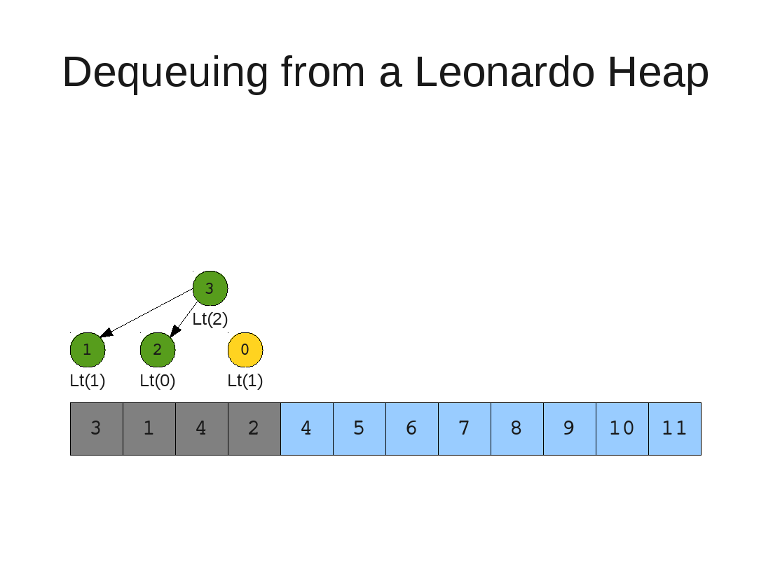

Slide 69


Slide 70
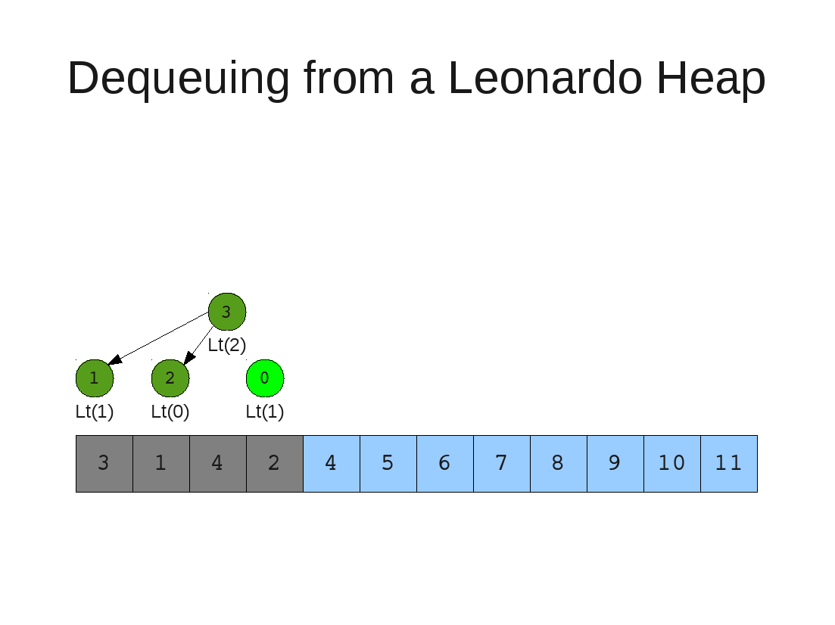

Slide 71


Slide 72


Slide 73


Slide 74
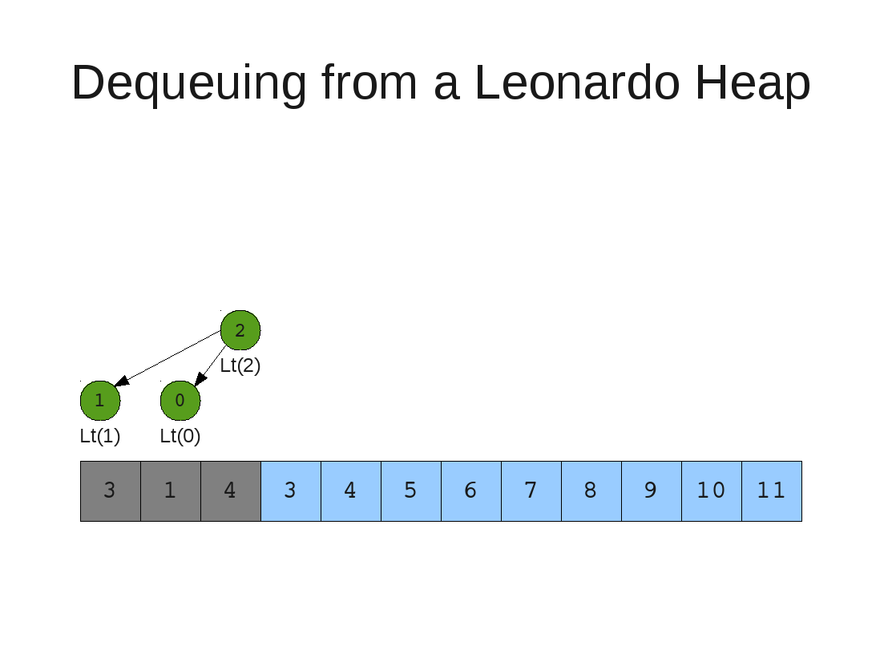

Slide 75
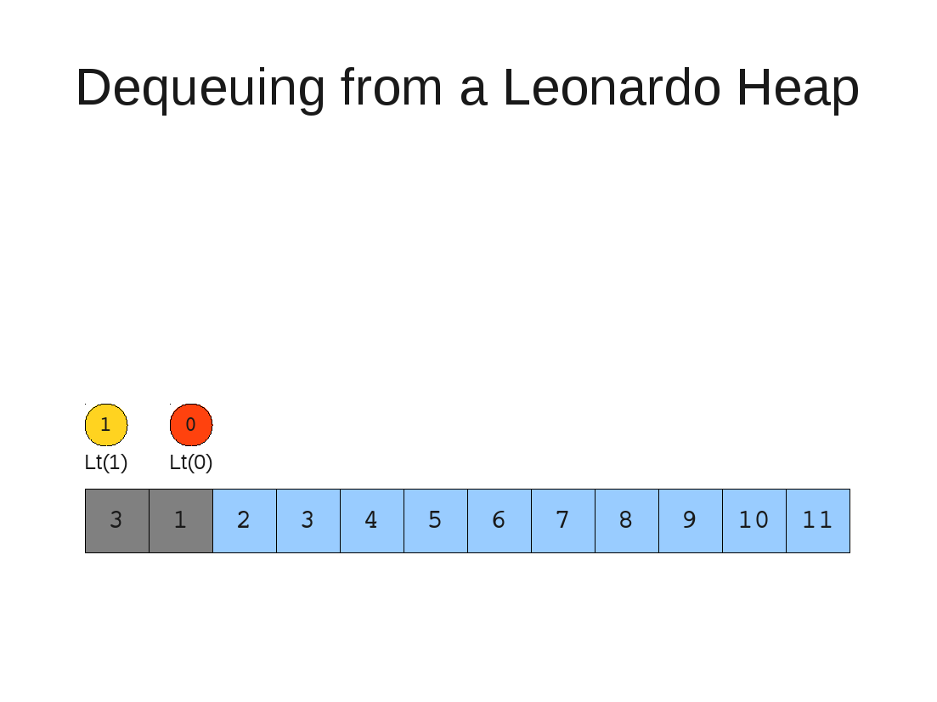

Slide 76
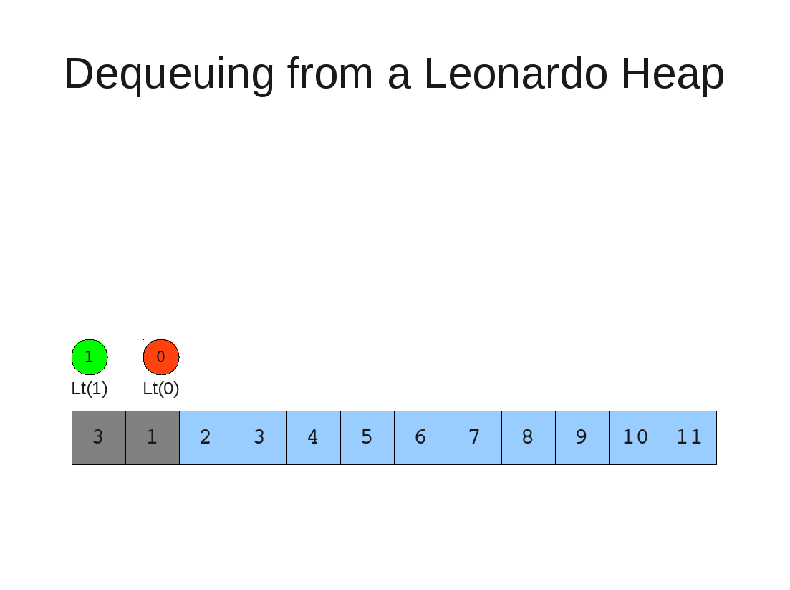

Slide 77
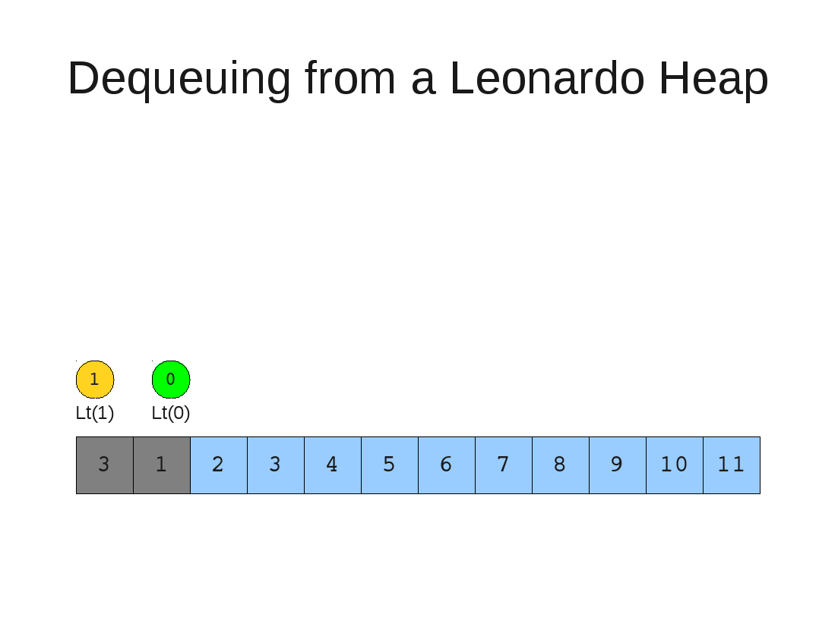

Slide 78


Slide 79


Slide 80
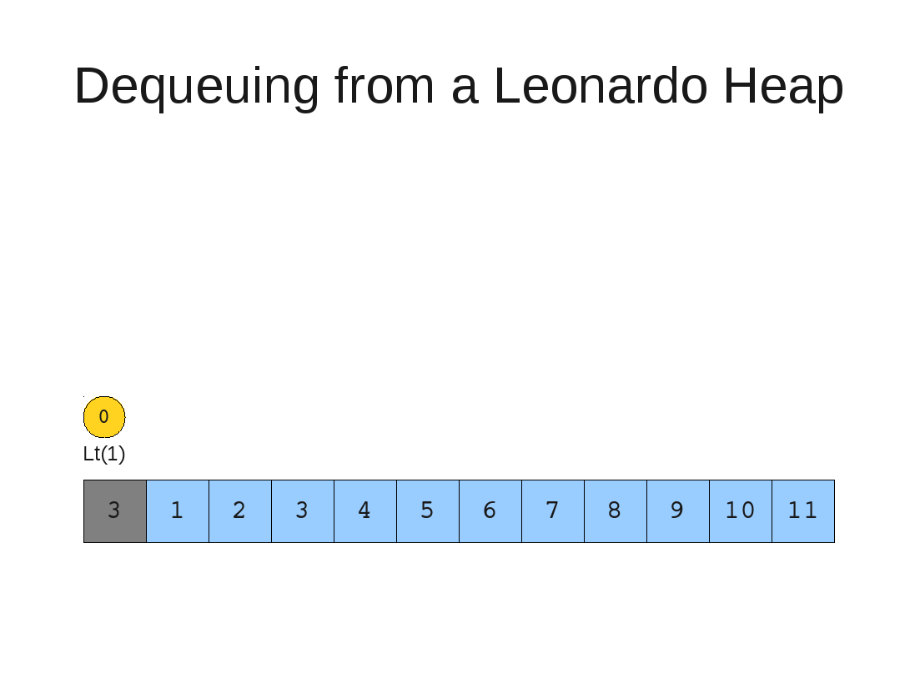

Slide 81
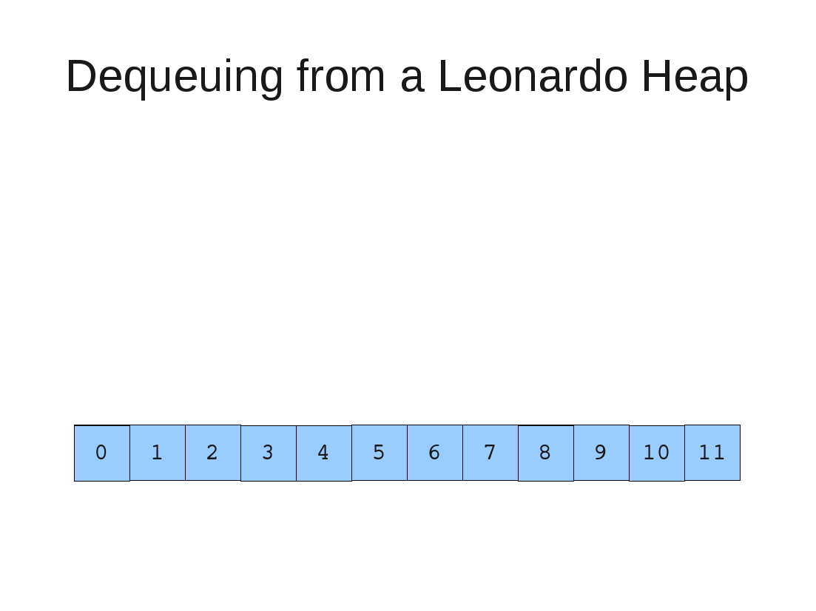

Slide 82
Algo & Runtime Analysis

Slide 83
Insert
  If last two heaps are two consecutive leonardo numbers
    Add new element as there root
  Else if the rightmost is not of size 1
    New element becomes a new heap of size 1. This 1 is taken to be L(1)
  Else
    New element becomes a new heap of size 1. This 1 is taken to be L(0)
Restore
  Set new element as "current" heap.
  While there is a heap to the left of the current heap and its root is larger than the current root and both of its child heap roots
    Swap(left-root with current).[Now current is that left root]
  While the current heap has a size greater than 1 and either child heap of the current heap has a root node greater than the root of the current heap
    Swap the greater child root with the current root. That child heap becomes the current heap.
C1
(Log N) times (Log N)
Log N

Slide 84
Dequeue
  Remove topmost node of rightmost heap.
  If it has no children, we're done.
  Otherwise:
  Fix up the left of the two heaps.
  Then fix up the right of the two heaps.
For N elements to dequeue running time is (N LogN) but this is asymptotically far less than Heap sort.
C1
Log N

Slide 85
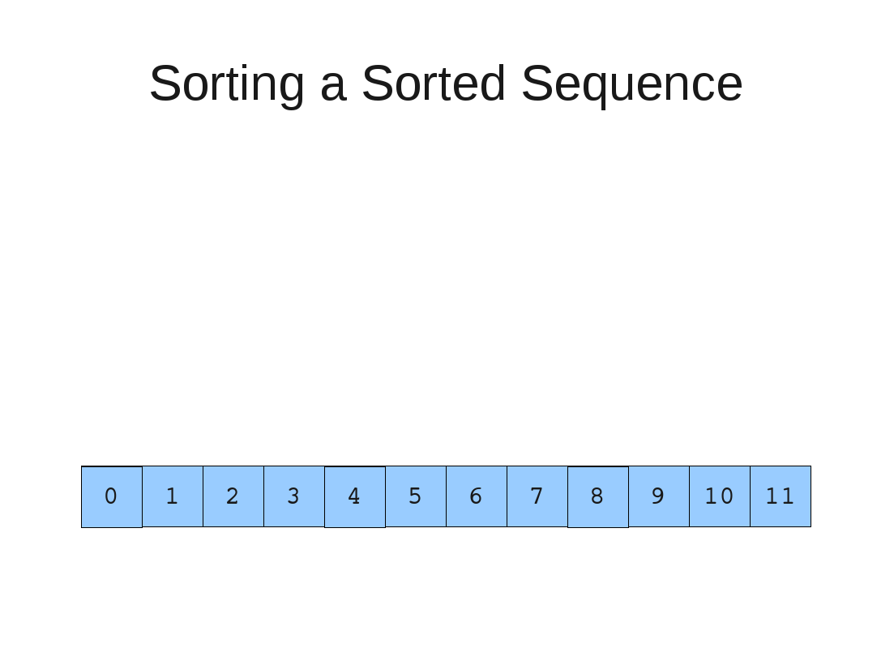

Slide 86


Slide 87


Slide 88


Slide 89


Slide 90


Slide 91


Slide 92


Slide 93


Slide 94


Slide 95


Slide 96


Slide 97


Slide 110


Slide 111
Conclusion
Compared to Heap Sort
  Efficient in Best Case
  Equal in Worst Case but the asymptotic graph is far less than Heap Sort

